Slide 1
Section Break
Housing Commission Session 3

Slide 2
Intermediate Tenures and Other Forms of Housing

Slide 3
New Local Plan: Intermediate Housing
Intermediate housing is defined in the new Local Plan as housing at prices or rents above those of social rent, but below market price or rents.
The new Local Plan defines “genuinely affordable homes” as homes for social rent, London affordable rent, London Living Rent and London Shared Ownership.
It also states that other affordable housing products may be acceptable if, as well as meeting the broad definition of affordable housing, they also meet the London Housing Strategy definition of genuinely affordable housing (generally meaning that they should be accessible to those whose household incomes fall under £60,000.)
There is still a strong need for intermediate housing in Waltham Forest.
 | Year | Shared Ownership | Total Affordable Homes
Completed | 2017/18 | 87 | 151
 | 2018/19 | 113 | 199
 | 2019/20 | 97 | 186
 | 2020/21 | 141 | 234
 | 2021/22 | 213 | 83
 | Total | 651 | 1153
Pipeline | Started | 1254 | 1775
 | Permitted | 276 | 904
 | Resolution to grant | 154 | 506
 | Total | 1684 | 3185

Slide 4
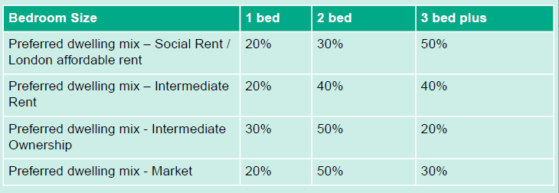
New Local Plan: Intermediate Housing
London Plan Policy H6 'Affordable Housing Tenure' states that residential development should apply a split of:
a minimum 30% low cost rented homes
a minimum 30% intermediate homes
Both the GLA and Waltham Forest SHMA show significant need for low cost rented homes
Therefore, new Local Plan requires remaining 40% for low cost rented homes.
To follow the Fast Track Route, applicants will be expected to follow 70:30 tenure split
The new Local Plan goes on to establish housing size for each tenure, based on the SHMA and Housing Waiting List:

Slide 5
New Local Plan: Other Housing
Other forms of housing will be supported where:
They meet the definitions of Build to Rent, Purpose-Built Student Housing and Purpose Built Shared Living Housing (See Table 8.3);
They contribute towards mixed, balanced and inclusive neighbourhoods and communities;
They are located in areas of good transport accessibility and well connected to local services and amenities;
They contribute to the delivery of affordable housing in accordance with the London Plan.
They are of high-quality design, including size of homes and accessibility.
Housing Type | Definition
Build to Rent | At least 50 homes. Covenant for at least 15 years. Clawback mechanism to ensure no incentive to break the covenant. All self contained homes, let separately. Unified ownership and on-site management Longer tenancies (3 years +) with break clauses for renters Rent and service charge certainty for length of tenancy Complaints procedure No up-front fees (except deposit)
Purpose Built Shared Living | At least 50 homes. Communal facilities and services including: communal kitchen external communal amenity space internal communal amenity pace laundry and drying facilities concierge community management, and bedding and linen changing and/or room cleaning Tenancies for a minimum of 3 months. Under single management, with a management plan provided.

Slide 6
New Local Plan: Other Housing
Where a development meets the criteria of Build to Rent, affordable housing offer can be Discount Market Rent (DMR) at genuinely affordable rent – preferably London Living Rent.
London Plan expects at least 30% at LLR, remaining 70% at a range of genuinely affordable rents.
Fast track route applies
If definition of Build to Rent is not met, scheme will be treated as ‘build for sale’ for the purposes of determining affordable housing.
DMR must be managed by Built to Rent provider and delivered without grant.
There is no requirement to be a Local Authority or RP to deliver of manage intermediate rented homes delivered without grant.
Tenure blind approach required.
In all cases, must fully meet the definition of intermediate housing and be affordable to those eligible for intermediate rented housing in London- using Mayor’s guidance.

Slide 7
New Local Plan: Other Housing
Where a development meets the criteria of Build to Rent, affordable housing offer can be Discount Market Rent (DMR) at genuinely affordable rent – preferably London Living Rent.
London Plan expects at least 30% at LLR, remaining 70% at a range of genuinely affordable rents.
Fast track route applies
If definition of Build to Rent is not met, scheme will be treated as ‘build for sale’ for the purposes of determining affordable housing.
 | Year | DMR | Total Affordable Homes
Completed | 2017/18 |  | 151
 | 2018/19 |  | 199
 | 2019/20 |  | 186
 | 2020/21 | 111 | 234
 | 2021/22 |  | 83
 | Total | 111 | 1153
Pipeline | Started | 99 | 1775
 | Permitted |  | 904
 | Resolution to grant | 17 | 506
 | Total | 116 | 3185

Slide 8
London Living Rent
Intended for middle-income Londoners, offering stable tenancies, with rents based on a third of local household incomes.
  Rent varies depending on ‘neighbourhood’ - The Mayor publishes benchmark London Living Rent levels for every neighbourhood in the capital, updated annually. These are based on a third of average local household incomes and adjusted for the number of bedrooms in each home.
  Across London, the average monthly rent for a 2-bedroom London Living Rent home is around £1,077 a month, almost three quarters of the median market rent.
  To ensure family-sized London Living Rent homes are affordable, the rent for a 3-bedroom home is set at no more than 10% above the 2-bedroom rent.
Eligibility:
  live or work in London
  either have a formal tenancy (for example, in the private rented sector) or live in an informal arrangement with family or friends as a result of struggling with housing costs
  maximum household income of £60,000
  not own any other residential home
  be unable to currently buy a home (including through shared ownership) in your local area.
We would like to secure more LLR in Waltham Forest

Slide 9
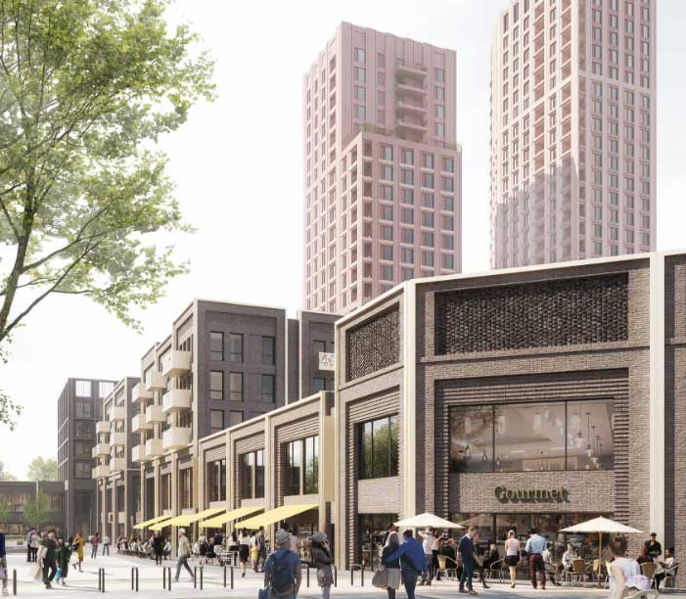
Build to Rent: Permission
Walthamstow Mall (Long Harbour)
538 BtR homes, including 99 DMR for key workers (in perpetuity).
£7.3 million for additional affordable homes in the wider area
DMR Marketing & Lettings Plan – rents, tenancies, management, identification of eligible renters (including income thresholds), allocation criteria and marketing
Post Letting Reports - income of tenants, professions, rent level and tenancy details, every 3 months, until fully let, and then every year.
Priority to Waltham Forest residents of eligible professions (defined in Section 106, include NHS, education, blue light, MOD, charity workers and some local authority staff)

Slide 10
Build to Rent: Permission
Walthamstow Mall (Long Harbour)
538 BtR homes, including 99 DMR for key workers (in perpetuity).
£7.3 million for additional affordable homes in the wider area
DMR Marketing & Lettings Plan – rents, tenancies, management, identification of eligible renters (including income thresholds), allocation criteria and marketing
Post Letting Reports - income of tenants, professions, rent level and tenancy details, every 3 months, until fully let, and then every year.
Priority to Waltham Forest residents of eligible professions (defined in Section 106, include NHS, education, blue light, MOD, charity workers and some local authority staff)
Studios & 1-beds to be let at no more than 80% of local market rent and 2-beds at no more than 71% of local market rent
The annual rent for 2-bed (including service charge) must not exceed 28% of £60,000 = £323/week
The annual rent for 1-bed = (including service charge) must not exceed 28% of £58,285 = £313.84/week
The annual rent for studio = (including service charge) must not exceed 28% of £43,500 = £234.23/week

Slide 11
Build to Rent: Permission
Walthamstow Mall (Long Harbour)
538 BtR homes, including 99 DMR for key workers (in perpetuity).
£7.3 million for additional affordable homes in the wider area
DMR Marketing & Lettings Plan – rents, tenancies, management, identification of eligible renters (including income thresholds), allocation criteria and marketing
Post Letting Reports - income of tenants, professions, rent level and tenancy details, every 3 months, until fully let, and then every year.
Priority to Waltham Forest residents of eligible professions (defined in Section 106, include NHS, education, blue light, MOD, charity workers and some local authority staff)
Studios & 1-beds to be let at no more than 80% of local market rent and 2-beds at no more than 71% of local market rent
The annual rent for 2-bed (including service charge) must not exceed 28% of £60,000 = £323/week
The annual rent for 1-bed = (including service charge) must not exceed 28% of £58,285 = £313.84/week
The annual rent for studio = (including service charge) must not exceed 28% of £43,500 = £234.23/week
Other Benefits:
New retail space
350 new permanent retail jobs
New children’s play area
Re-landscaped town square,
new step-free access to the Victoria line.

Slide 12
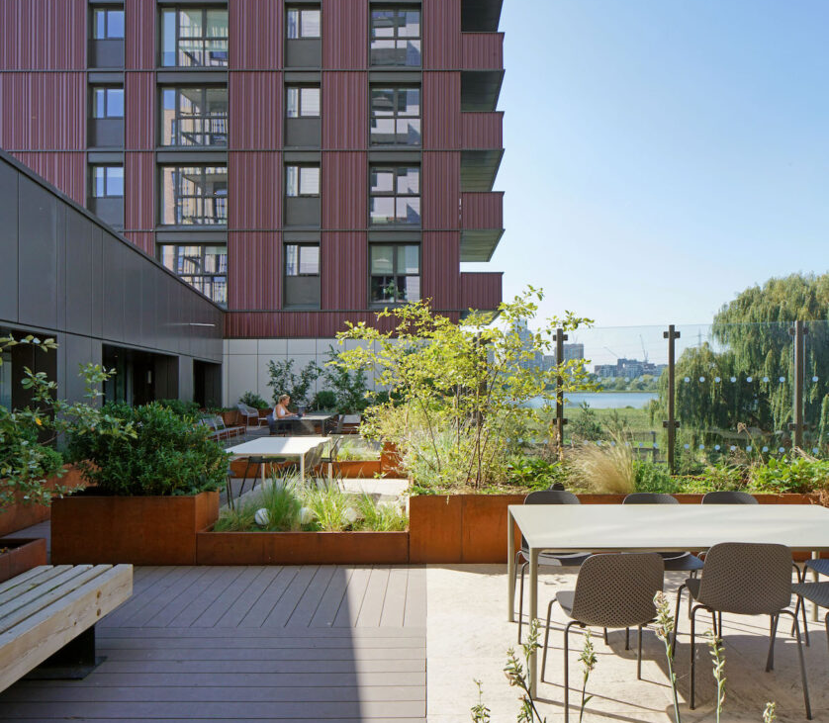
Build to Rent: Delivered
Blackhorse Mills (Legal and General)
479 BtR homes, including 85 DMR for key workers and 19 London Living Rent.
Monitoring reports submitted by the developer show that average income of DMR renters is £36,000, but as low as £20,000. Homes are being rented to range of key workers but large majority are teachers and NHS staff.
Equipment Works (Greystar)
Originally proposed as a conventional for sale housing scheme; the private units have been sold to Greystar and delivered as private rented
Your Sub head goes here
in 42pt text. Keep to a maximum
of three lines where possible

Slide 13
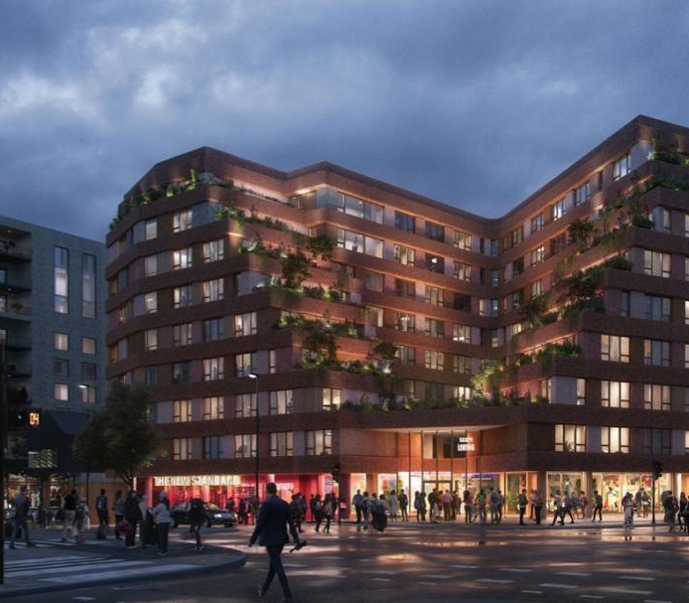
Shared Living
The Standard (Scape)
273 purpose built shared living rooms
Dedicated music and cultural venue
The site is ideally suited to this kind of residential accommodation, as the co-living and music venue can coexist without incurring agent of change issues more likely to be experienced by conventional housing.
Your Sub head goes here
in 42pt text. Keep to a maximum
of three lines where possible

Slide 14
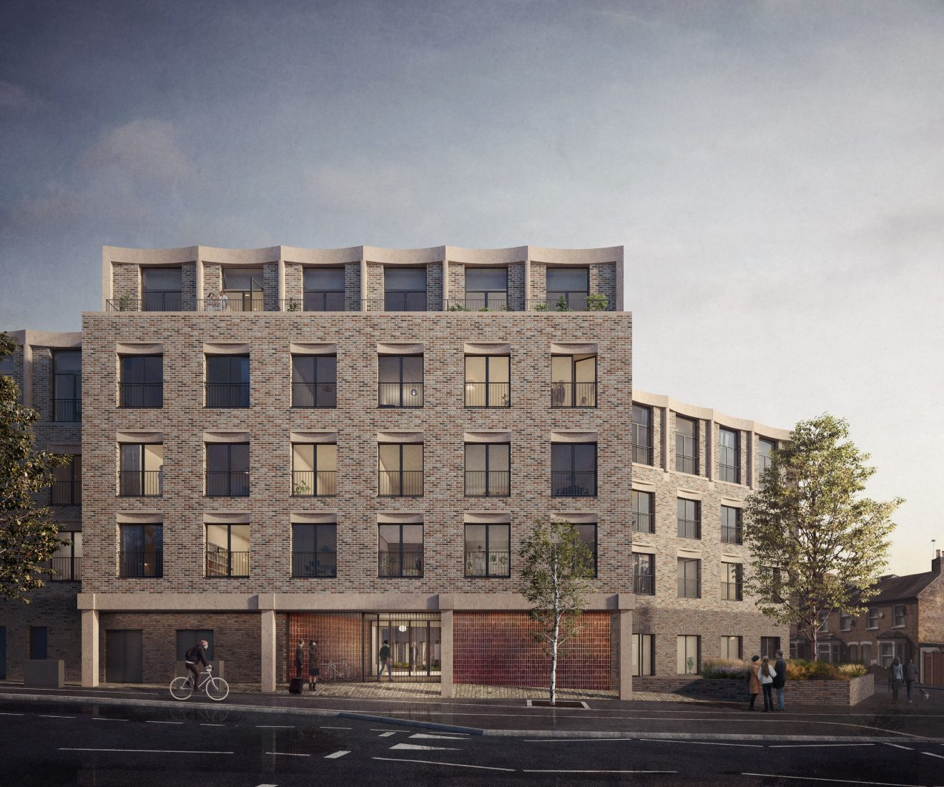
Discount Market Sale
Pocket Homes
Two Pocket Homes schemes currently under construction that will deliver new homes for discount market sale.
Forest Road: 90 one bedroom discounted Pocket homes
Osier Way: 197 one, two and three bed discounted Pocket homes.
Both will be available for first time buyers living or working in Waltham Forest who would otherwise not be able to afford to buy a property in the borough.
Your Sub head goes here
in 42pt text. Keep to a maximum
of three lines where possible

Slide 15
Discussion Points
There is demand for affordable intermediate products – but the highest need is for low cost affordable rent.
Can we diversify the mix of affordable products on schemes if shared ownership subsidises delivery of London Affordable Rent and/or Social Rent?
  Council direct delivery?
  Sixty Bricks?
Can we leverage more DMR – particularly LLR – from private developers?
What are the management implications of providing DMR (particularly LLR) as part of a ‘homes for sale’ scheme?
What could a PRS/ BtR Strategy for the borough look like?
Your Sub head goes here
in 42pt text. Keep to a maximum
of three lines where possible

